Slide 1
I-80 Coalition September 25, 2012 Reno, Nevada

Slide 2
Maintenance

Slide 3
Winter 2011-2012?
The winter that wasn’t
Very little snow
Very strong winds
Winter maintenance budget 27 million
Expended 21.2 million.
6 million under-run was allocated to construction projects.

Slide 4
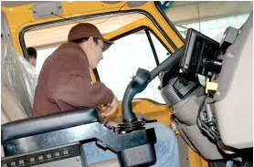
Maintenance Vehicles
All plows now equipped with AVL
System provided by CompassCom
Plow position and metrics

Slide 5
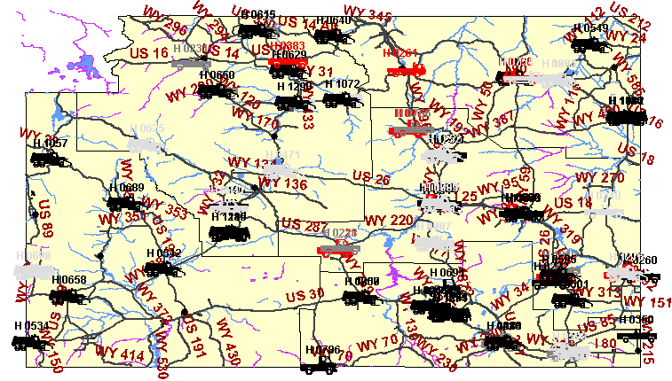
AVL

Slide 6
Freight/CVO’s

Slide 7
Freight Planning
Starting consultant selection process for new State Rail Plan
Within six months or so, will embark on a State Freight Plan, to be developed concurrently with the rail plan.
Questions: mark.wingate@wyo.gov

Slide 8
Truck Blowovers
Closure to Light, High Profile Vehicles (C2LHPV)
65 mph gusts or 1 blowover
2011-2012 First Full Season
Hot Spots
I-25 Cheyenne to Wheatland
I-80 MP 272 - 284

Slide 9
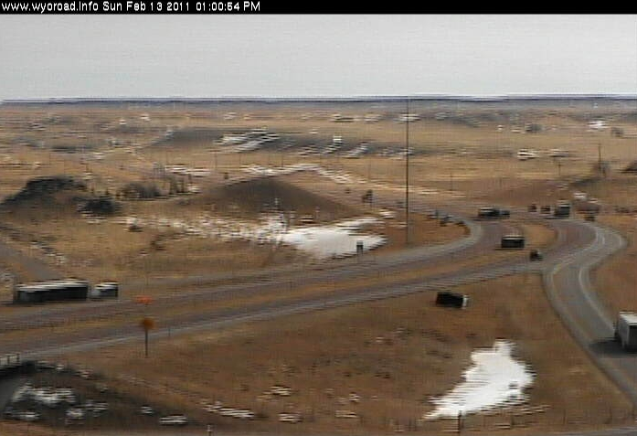
C2LHPV
Very Strong Wind Year
Very few blow-overs/closures on I-25
Significant number on I-80

Slide 10
CVOP
Discussed in detail tomorrow
Weather forecasts targeted to CVO’s

Slide 11
Travel Information

Slide 12
Text-based Travel Information
Customers
Hotels
Radio stations
Low-bandwidth users
etc.

Slide 13
Old Systems
Format evolved over many years
Selection by WYDOT District
Selection by City
Selection by Route
No text-based option for construction information
No direct link to weather sensors or webcams from text-based systems

Slide 14
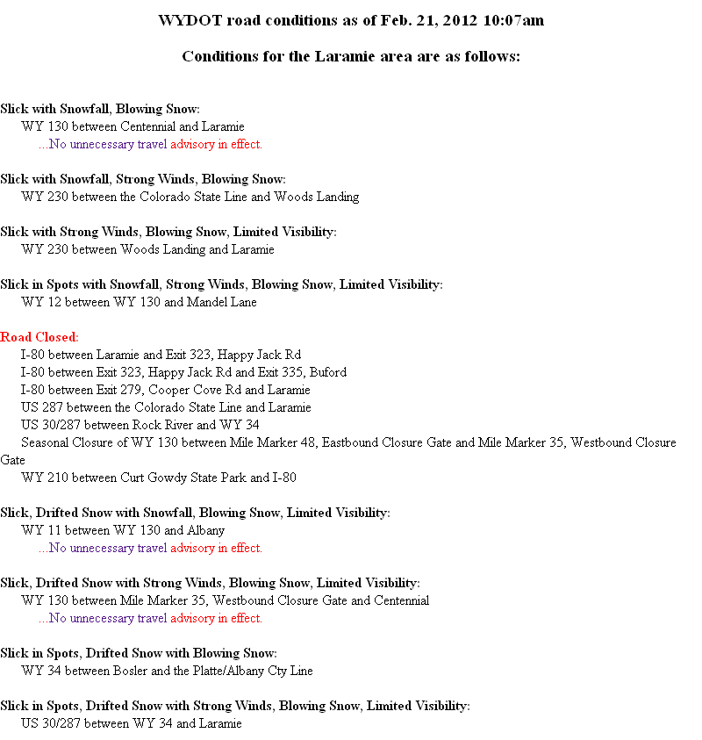
Old Method (By City)

Slide 15
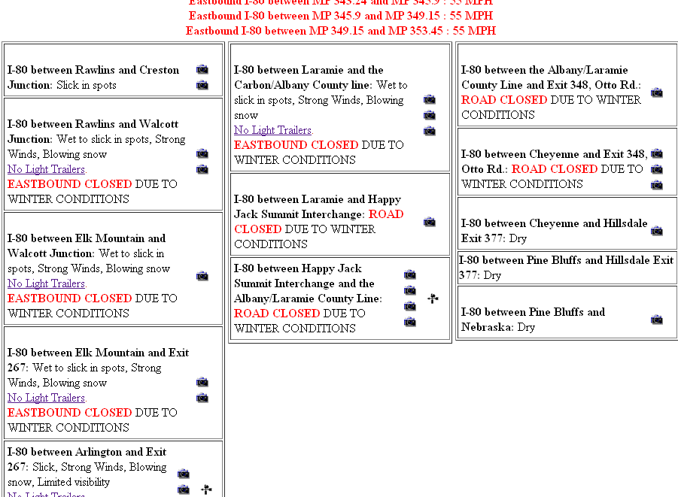
Old Method (By District)

Slide 16
New Method
Formatted data (columns)
FHWA Guidelines
Colors added to indicate severity
Concept developed by Utah
Users able to select based on:
Route
District
City

Slide 17
Impact Levels
Four impact levels

Slide 18
New Method

Slide 19
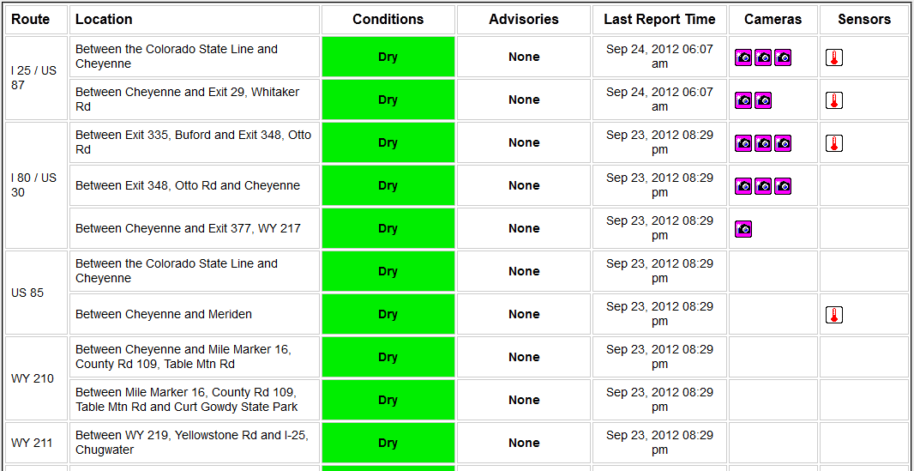
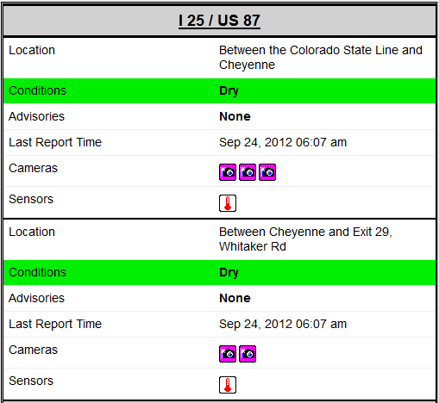
Responsive Web Design

Slide 20
Travel Information Trip Generators

Slide 21
Trip Generators
University of Wyoming Sporting Events
One University in Wyoming
People travel 300 miles to attend football, basketball, wrestling, volleyball games
Many events scheduled during peak storm season
Casper Events Center
State Tournaments
Plays, Concerts, Etc.

Slide 22
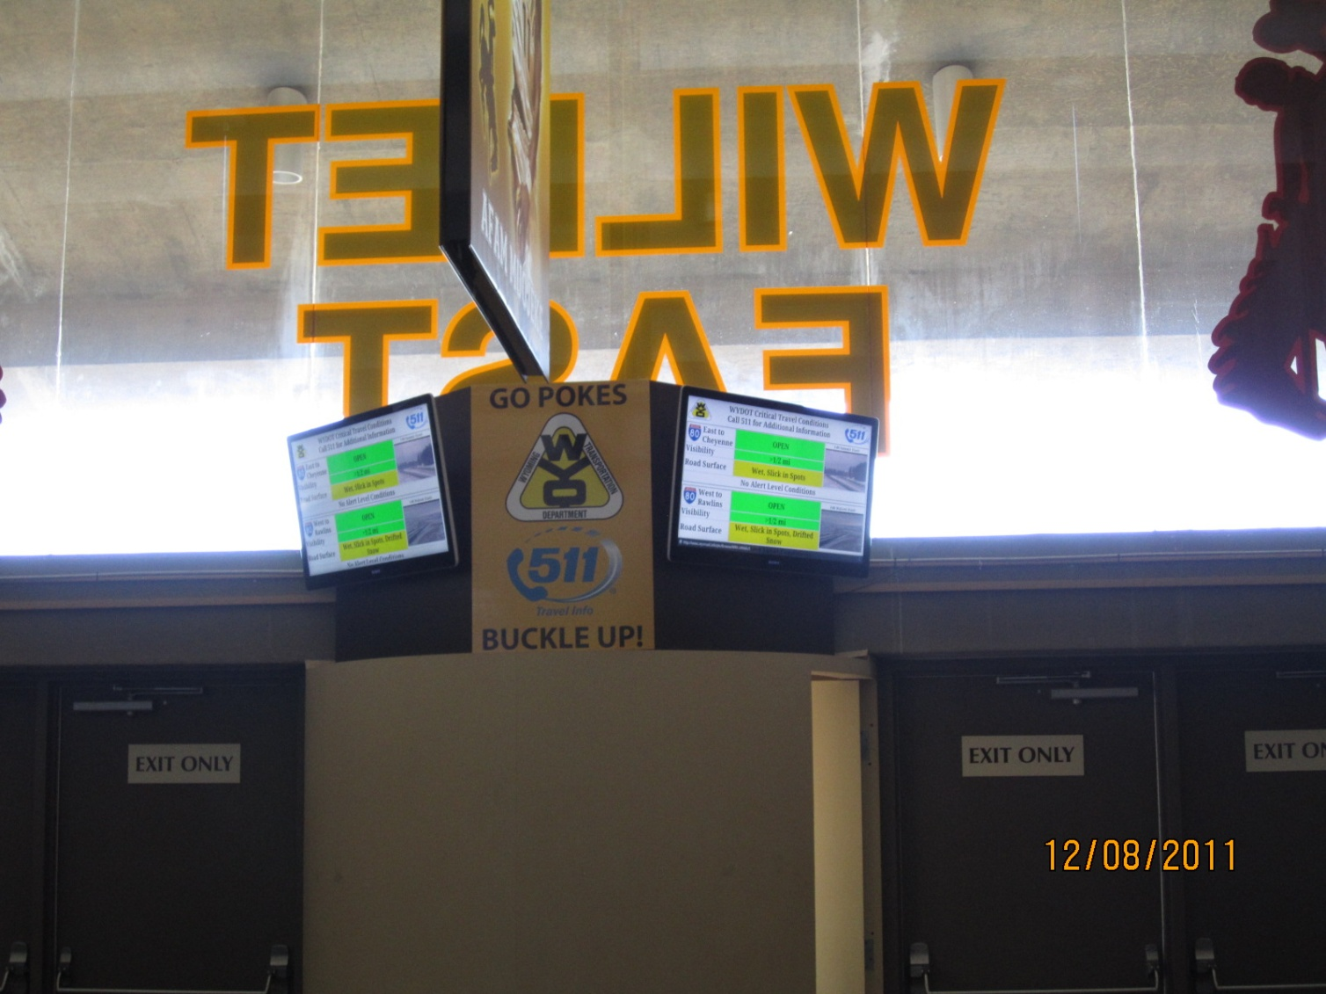
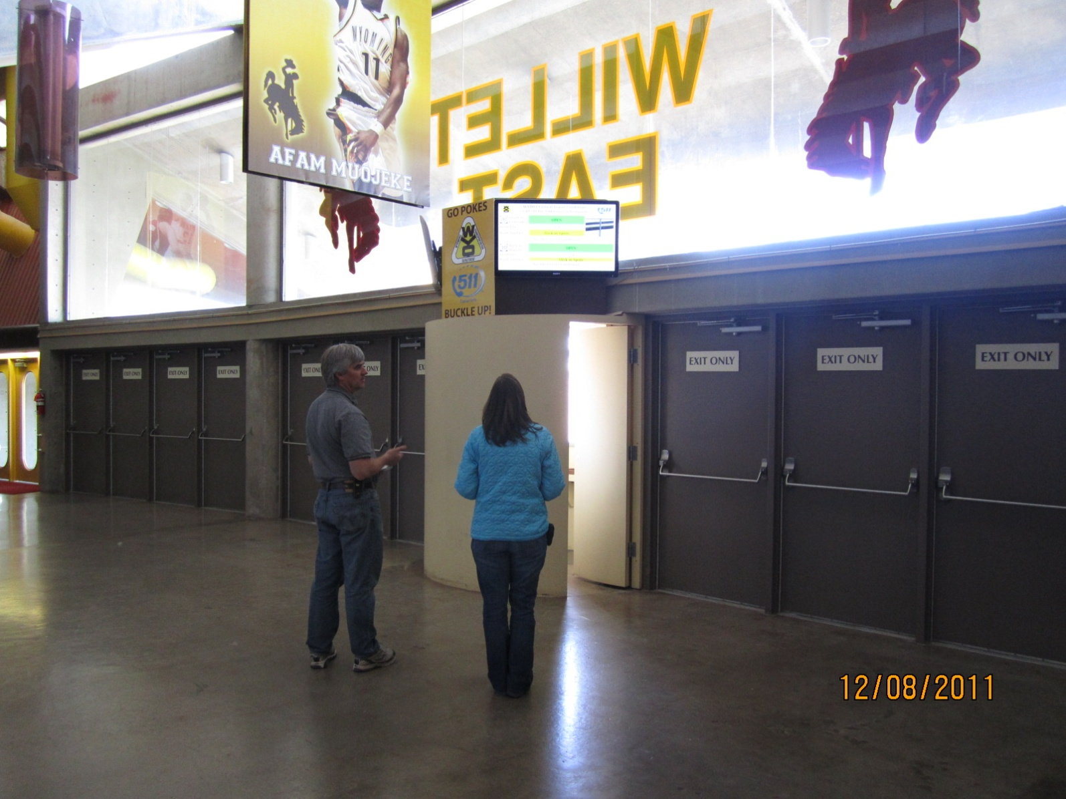
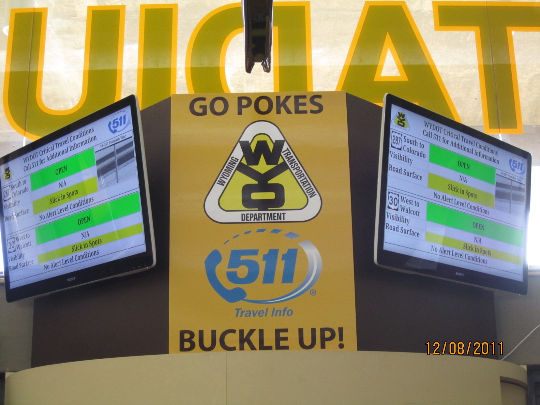
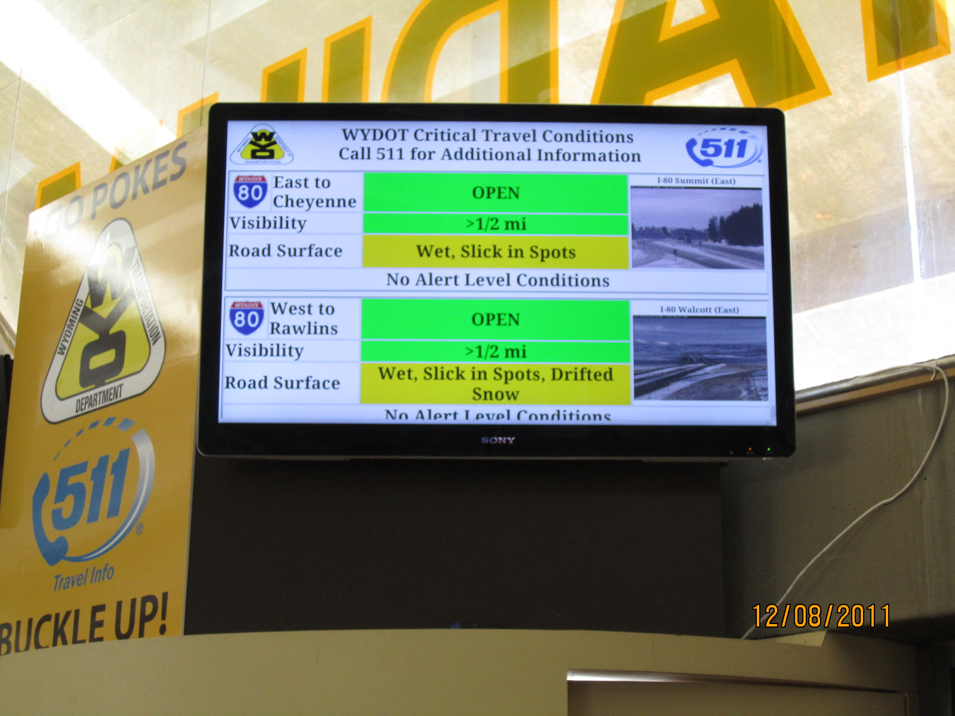
Site Specific Travel Information

